Slide 1

GOVERNMENT ENGINEERING COLLEGE
WEST CHAMPARAN
Spam Message Detection Using Machine Learning

Slide 2


Presented to-
DR. RAFEEQ AHMED SIR
By-
RASHMI KUMARI (22152146049) & ANNU KUMARI (22152146050)
CSE(Cyber Security)

Slide 3
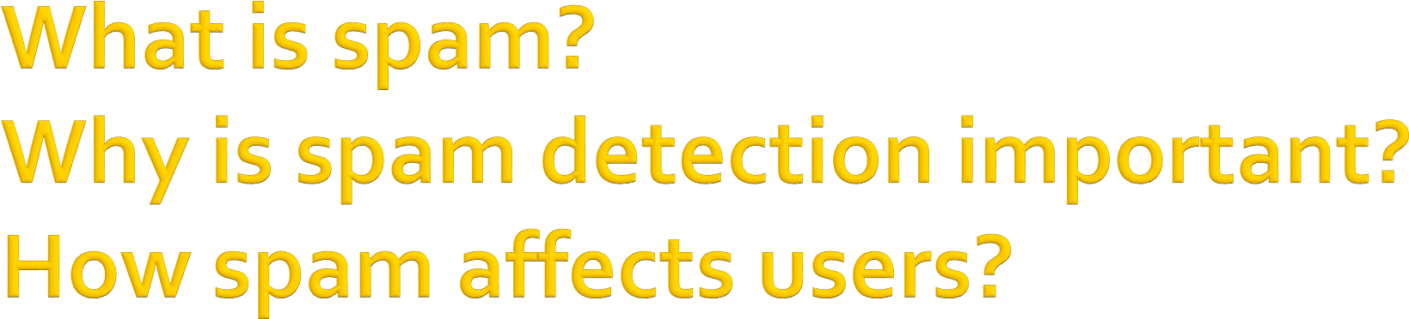
Unwanted or irrelevant messages sent in bulk over the internet. Includes junk emails, fake ads, phishing messages, and harmful links
- Why is spam detection important?
Protects users from fraud and phishing attacks.
Saves time and storage space.
Prevents malware or virus infections.
Keeps your inbox clean and organized.
- How spam affects users
Leads to financial losses through scams.
Steals personal or sensitive data.
Can infect computers with viruses or ransomware.

Slide 4
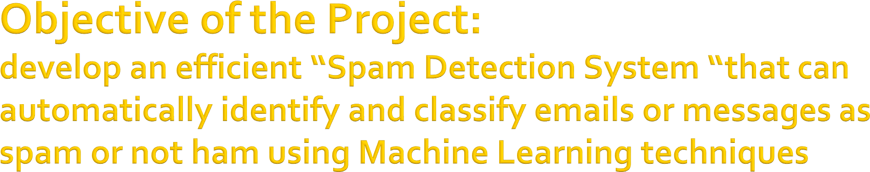
To classify messages as Spam or Not Spam using Machine Learning.
To automate the process of spam detection with high accuracy.
To deploy the trained model using a simple Gradio web app.

Slide 5
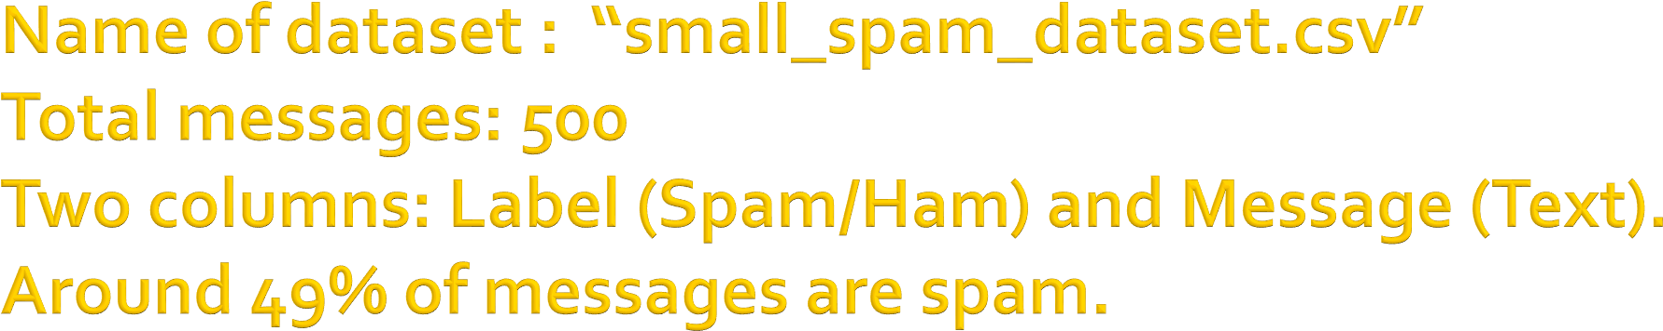
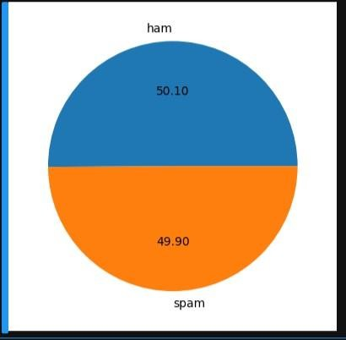
pie chart showing % of Spam vs Ham:

Slide 6

Lowercasing the text.
Removing punctuation and special characters.
Tokenization and stopword removal.
Applying stemming using PorterStemmer.
Converting text to numerical form using TF- IDF.

Slide 7

Algorithm used: Naive Bayes.
TF-IDF Vectorizer used to convert text into feature vectors.
Dataset split into training and testing sets
(50:49).
SMOTE used to balance spam and ham samples.
Model trained to achieve accuracy.

Slide 8
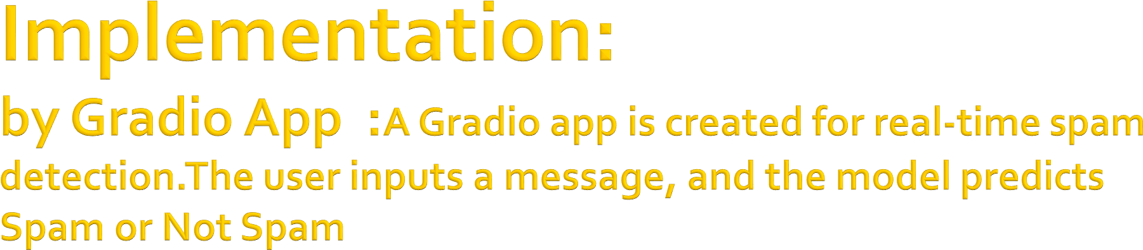
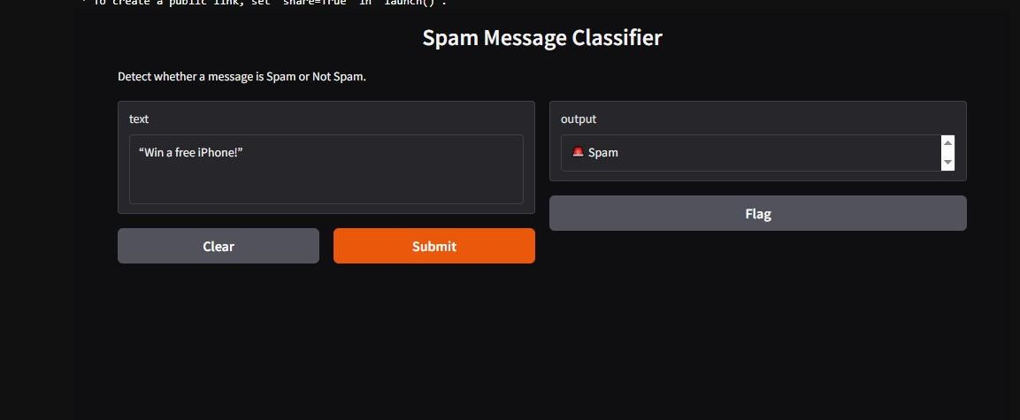
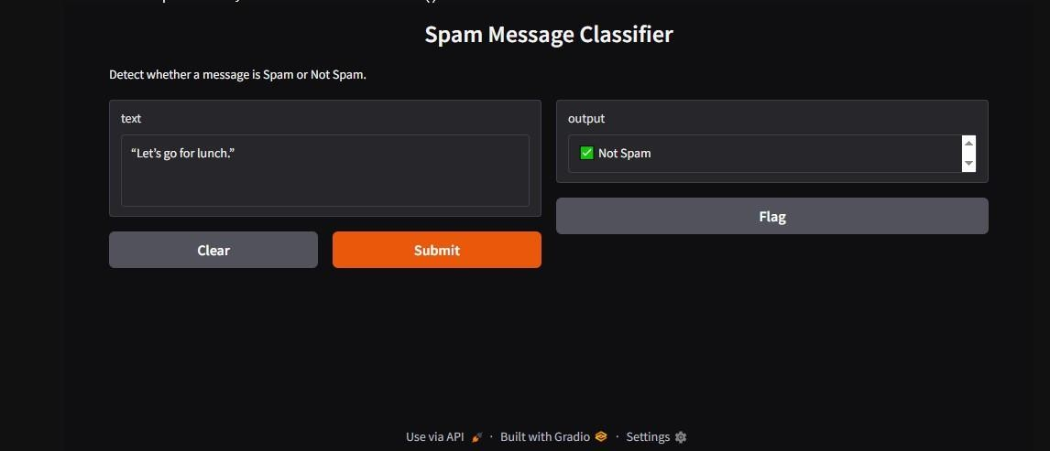
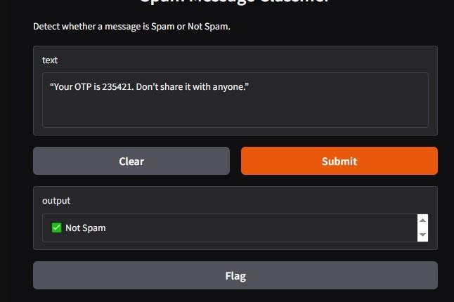

Slide 9

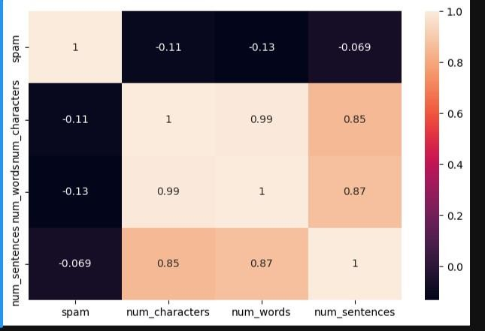
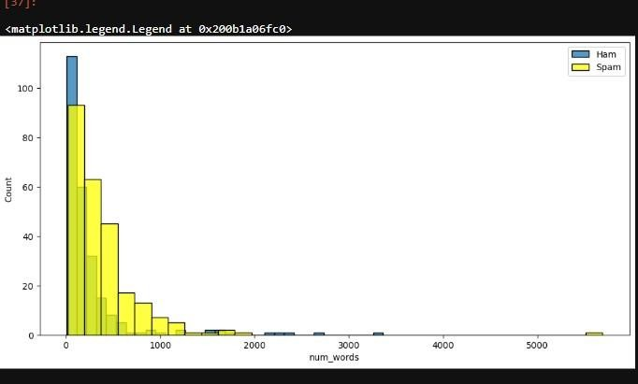
-Accuracy achieved
- Confusion matrix or classification report:

Slide 10

Dataset source: kaggle
Tools used : Python, Scikit-learn, NLTK (Natural Language Toolkit), Gradio,etc
Open source
-IDE: Jupyter Notebook.

